Slide 1
Homework 3 Overview
Your stubs from Homework 2 must be pushed to the repo
Before implementing, correct stubs
See your mentors for guidance
Part 1: Implement 1-2 hardest methods
See your mentors for guidance

Slide 2
Homework Overview
Part 2: Add tests for those functions!
Discussion today over testing in Minecraft scripting
Sample at https://github.com/rebeccamcfadden/mc_wumpus_samples/tree/main/examples/stub_example_pack
Can either be through a GUI system or /scriptevent
Push your object + test code to your team's repo!

Slide 3
Test Classes
Write classes to test functions where you know the expected input and output
Example: If you own a function that manages the player’s emeralds, add 100 emeralds to an empty player inventory and make sure the inventory reports back 100 emeralds
Can be tested by commands or with a GUI:
Commands: /scriptevent <…>
UI that runs the commands

Slide 4
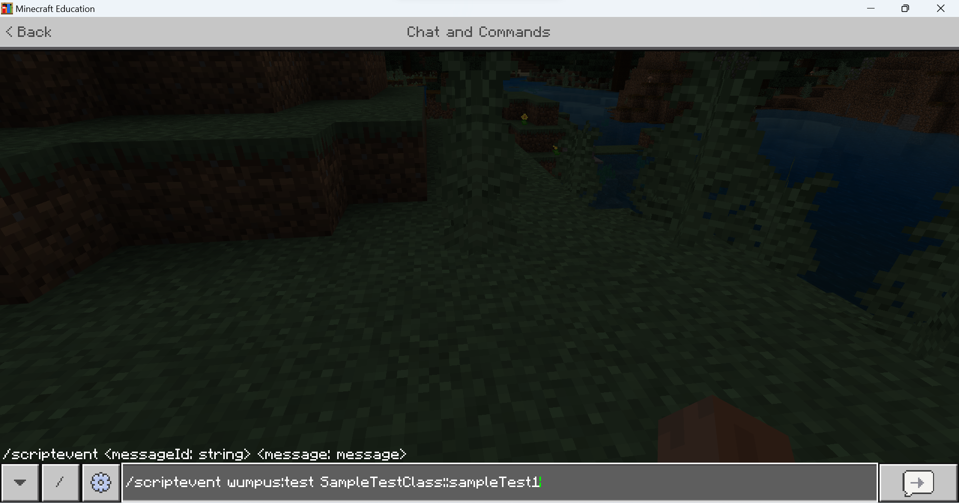
Testing Example: Commands

Slide 5
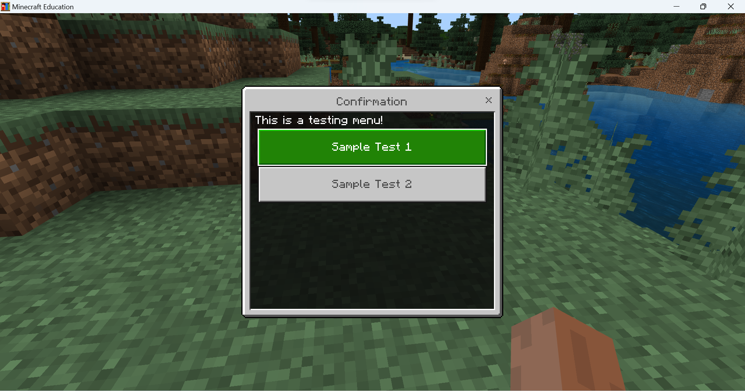
Testing Example: UI

Slide 6
Test Classes
Different classes should have different test classes
Ie- cavegenerator.js could be tested by cavegenerator_tests.js
The testing is not part of the game but should still be present in your repo!

Slide 7
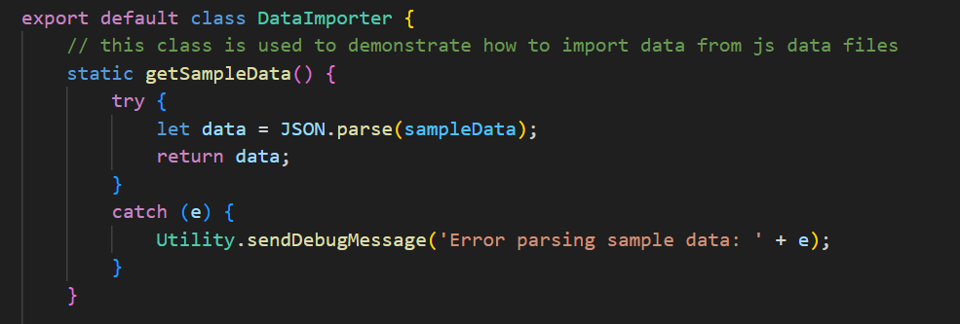
Test Class Example- Data and Function
Notes:
Sample data: some arbitrary data to test JSON parsing that is already known
Data importer: A class that’s designed to import JSON data. getSampleData loads and parses the sample data

Slide 8
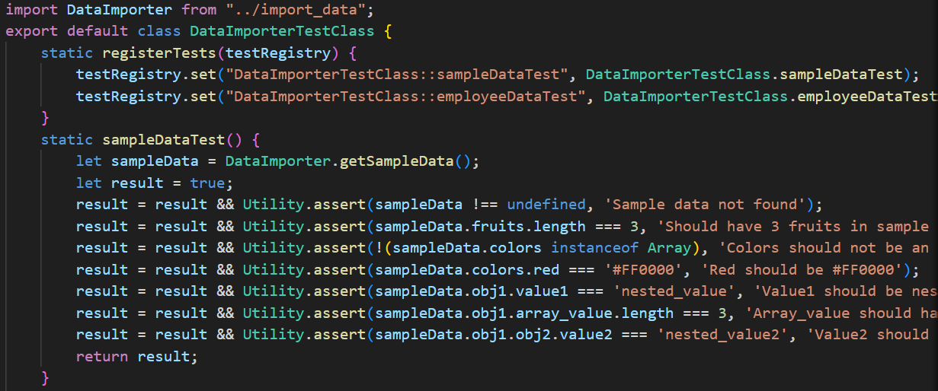
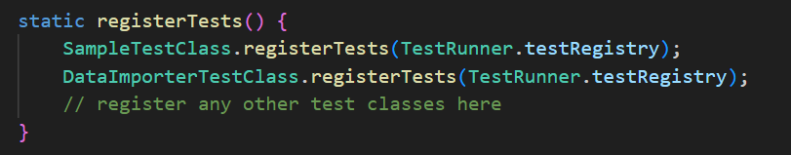
Test Class Example- Test class
Test_main.js
Notes:
Data importer class is tested by DataImporterTestClass. Register tests maps the tests to a string name. Notice that the sample data test class includes some assertions we know should be true if parsing went correctly. For example, we saw three fruits at the start of the sample data, and we build an assert around that condition (note: asserts will go off if expected statement is false)

Slide 9
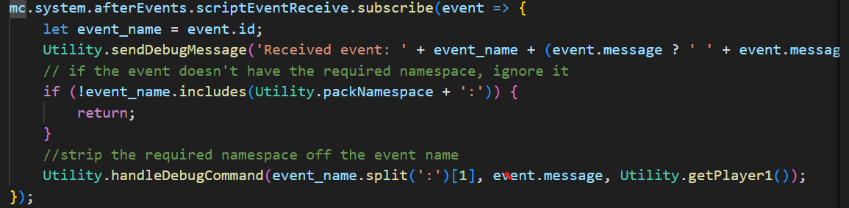
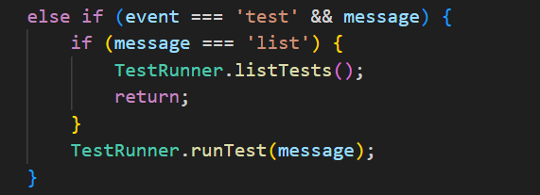
Test Class Example- Running Tests
Notes:
Utilities class subscribes to behavior pack events and sends info to the handle debug command function. In the case of running wumpus:test …, tests can be run directly through the command line.

Slide 10
Project layout
How to organize test apps + team project?
\Wumpus
\Cave
Cave.js
CaveTest.js
\GameLocations
GameLocations.js
GameLocationsTest.js
\GameControl
GameControl.js
GameControlTest.js
Main.js
* Can also do tests in a separate folder, as seen in the example

Slide 11
Sample Code
mc_wumpus/examples/stub_example_pack
Sample javascript classes
Class with corresponding test class
Test runner with ability to register tests from multiple classes
Utilities with asserts, event registration
UI sample
JSON parsing sample

Slide 12
Sample Code
mc_wumpus/examples/GameLoopSampleJS
Sample showing how to build a game loop in behavior packs
Demonstrates fetching player coords

Slide 13
Enabling Beta APIs (highly recommended)
Allows beta versions of some APIs
Test example we’re about to go through uses them!
Instructions at mc_wumpus_samples/resources/EnableBetaAPIVersion.md

Slide 14
Enabling content logs (recommended)
Adds extra logging to assist in debugging errors
Instructions at mc_wumpus_samples/resources/EnablingContentLog.md

Slide 15
Checkpoint
Next class every member must be able to demonstrate
Code that builds without errors
Stubs + at least two fully implemented methods
An class that tests the methods that can be run through the command line or a UI
Push your Wumpus code + test code to your team repo

